Slide 1
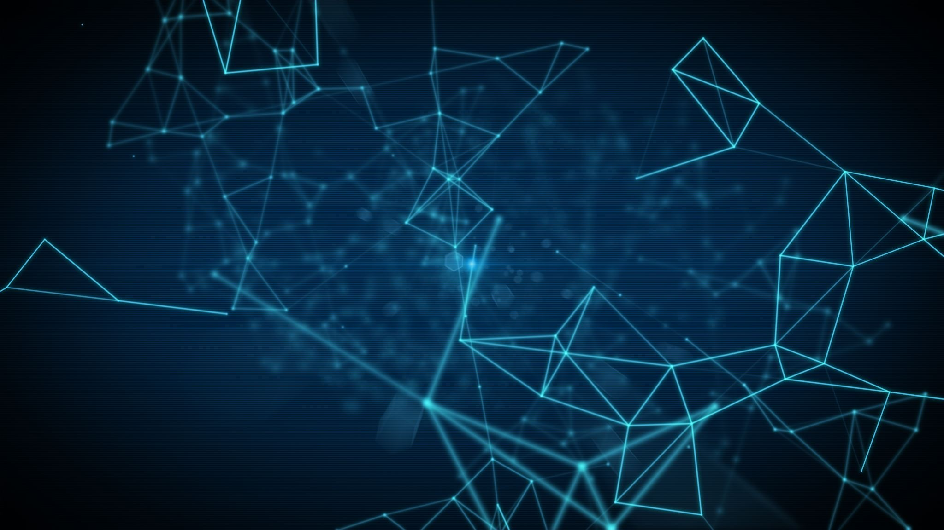
Skin Disease Image Detector Application
By:
Mennatullah Mahmoud 18101713
Omnia Saeed 18102396
Menna Abdelsattar 18101590
Youmna Ramadan 18101142

Slide 2
Introduction
skin is the largest organ of human body, containing blood vessels, lymphatic vessels, nerves, and muscles.
Skin diseases are common than other diseases, Skin diseases may be caused by fungal infection, bacteria, allergy, or viruses, etc. It may change texture or color of the skin.
Recent researchers have found the availability of cures for these diseases if they are detected in the early stages
Therefore, skin diseases must be diagnosis early to reduce their development and spread so identifying the infected area of skin and detecting the type of disease is useful for early awareness

Slide 3
Cont.
With the increase in medical technology the concept of computer being used for the diagnosis of skin diseases has been around recently.
The most prevalent technology which is being used for the prediction is Artificial Intelligence using Machine Learning.
Machine Learning is that branch of computer studies that gives the potentiality to the computer to grasp without being characteristically programmed.
Here the machine learns itself and divide the data provided into the levels of prediction and in a very short period of time gives the accurate results.

Slide 4
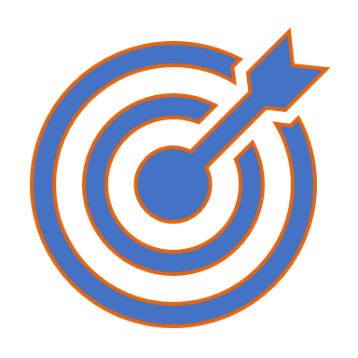
Our Aim

Slide 5
A detection application is proposed which enables the users to detect and recognize skin disease.
Detection application system is a system used for detecting whether a disease is present or not, and then classifying the type of disease, if present.
In order to identify whether a disease is present or not, the system must be trained to recognize normal conditions of system activity.
The system successfully detects 8 different types of skin diseases.
This method takes the digital image of the disease affecting any skin area, then use image analysis to identify the type of disease
we build an app using flutter and dart language to help using our approach anywhere
Finally, you can get the results by uploading the image to our application.
Our proposed approach is simple, fast and does not require expensive equipment other than a camera and smart phone to download our app and upload the picture

Slide 6

Our Steps
Our project is composed of :
- Dataset
- Machine Learning Model
- Mobile Application

Slide 7
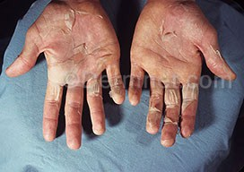
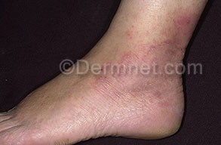
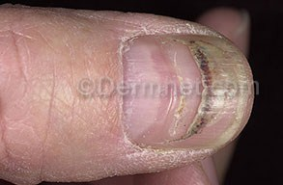
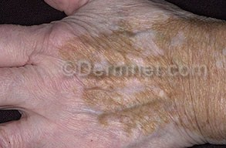
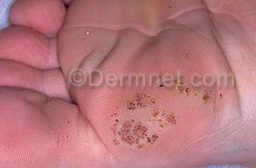
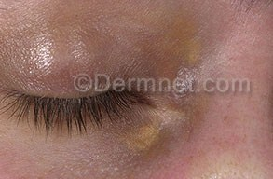
Dataset
We used the “Dermnet” website to download datasets. The dataset is composed of 8 categories(diseases) while every category includes 20~30 of type jpg and PNG. The used diseases are: (“Scarlet Fever”, “tinea”, “trauma”, “vitiligo”, “Warts plantar”, “white Superficial Onychomycosis”,” Xanthoma”, and “Measles”).
We used this dataset in google cloud platform to train and test it.
Scarlet Fever
Tinea
Trauma
Vitilligo
Warts Plantar
Xanthoma

Slide 8
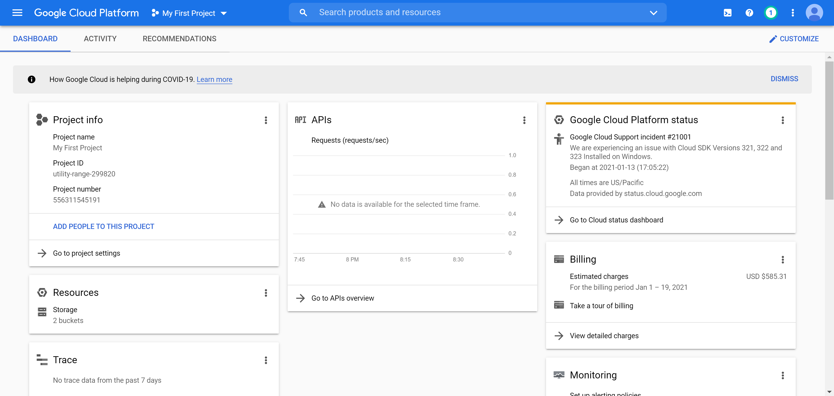
Google Cloud Platform
To make our machine learning model we used Google Cloud Platform (GCP) which is offered by Google

Slide 9
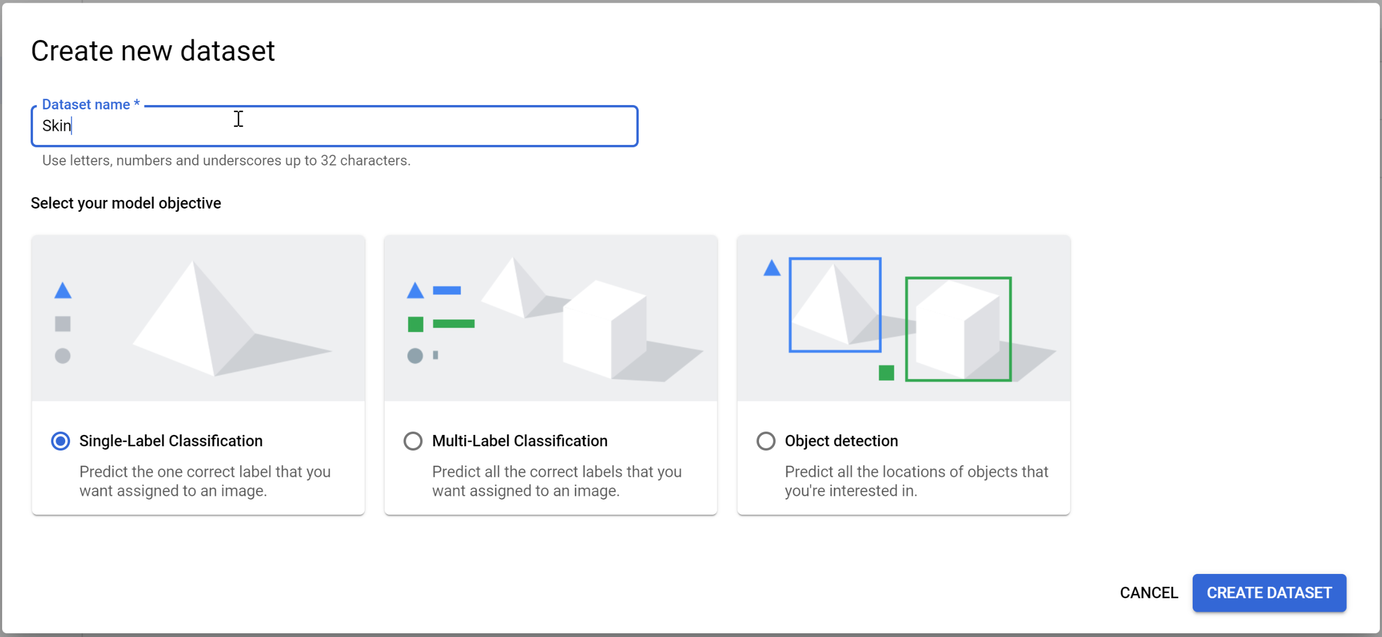
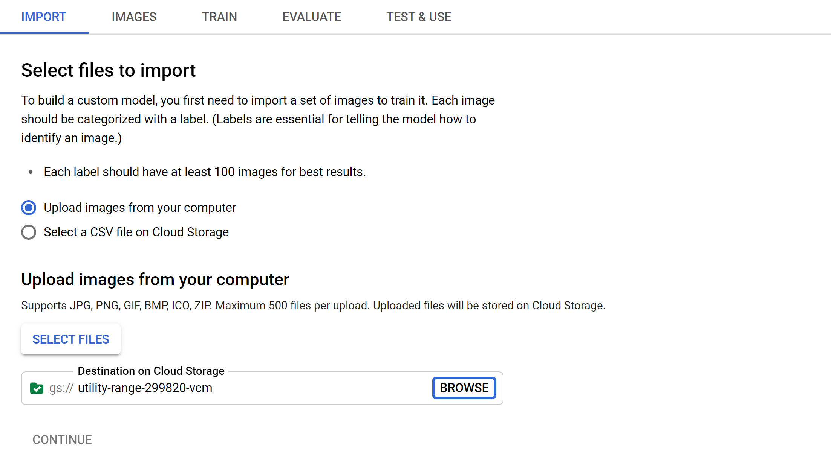
Training our Model
We create a dataset in autoML
Import the images to our cloud

Slide 10
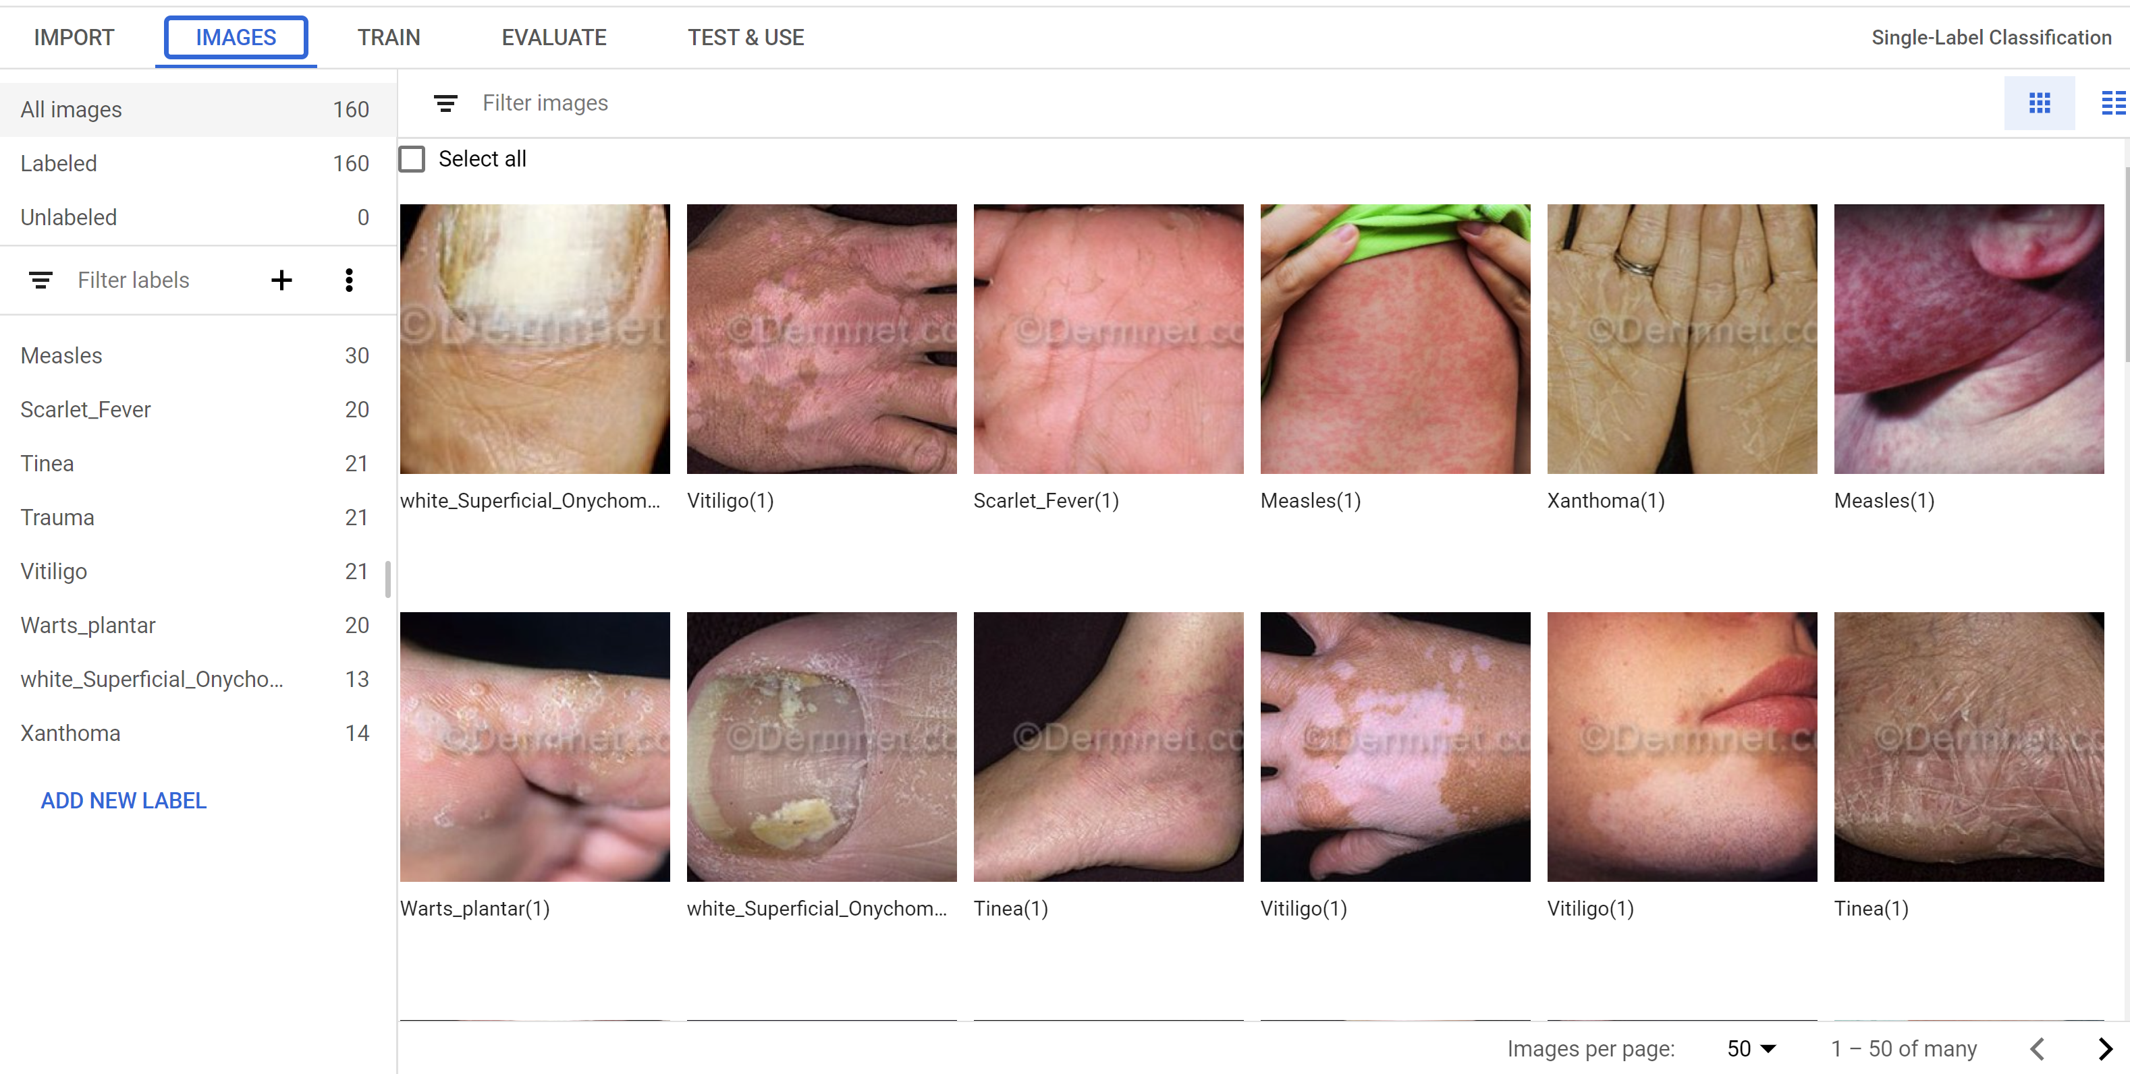
After the import is completed, the images must be all uploaded each is labeled with its disease.
we are ready to train our model. The dataset is divided to 80% of the image for training the model, 10% for validation and the last 10% for testing.

Slide 11

The result

Slide 12
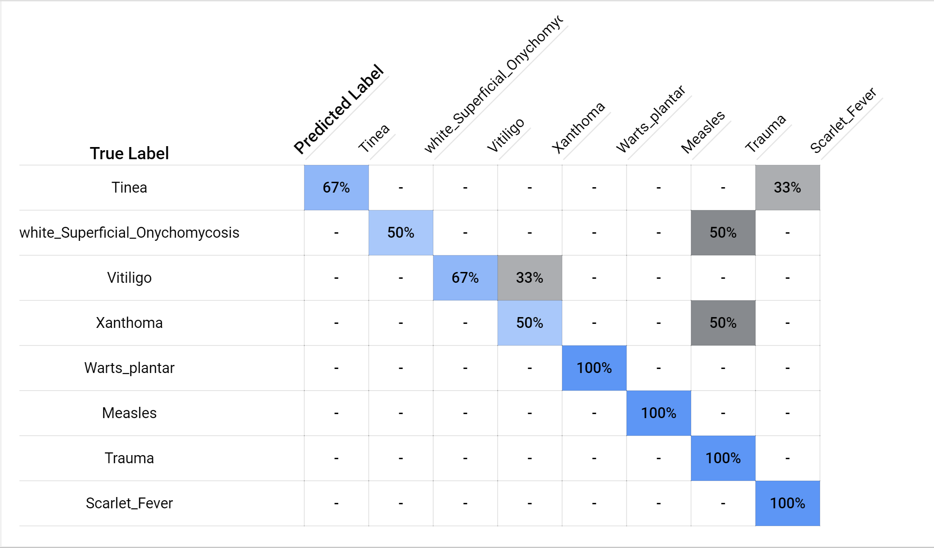
After training our model by the images uploaded, the result came with precision of 84%. Besides, there is a confusion matrix to clarify the outputs of the test images whether it is true or false.

Slide 13
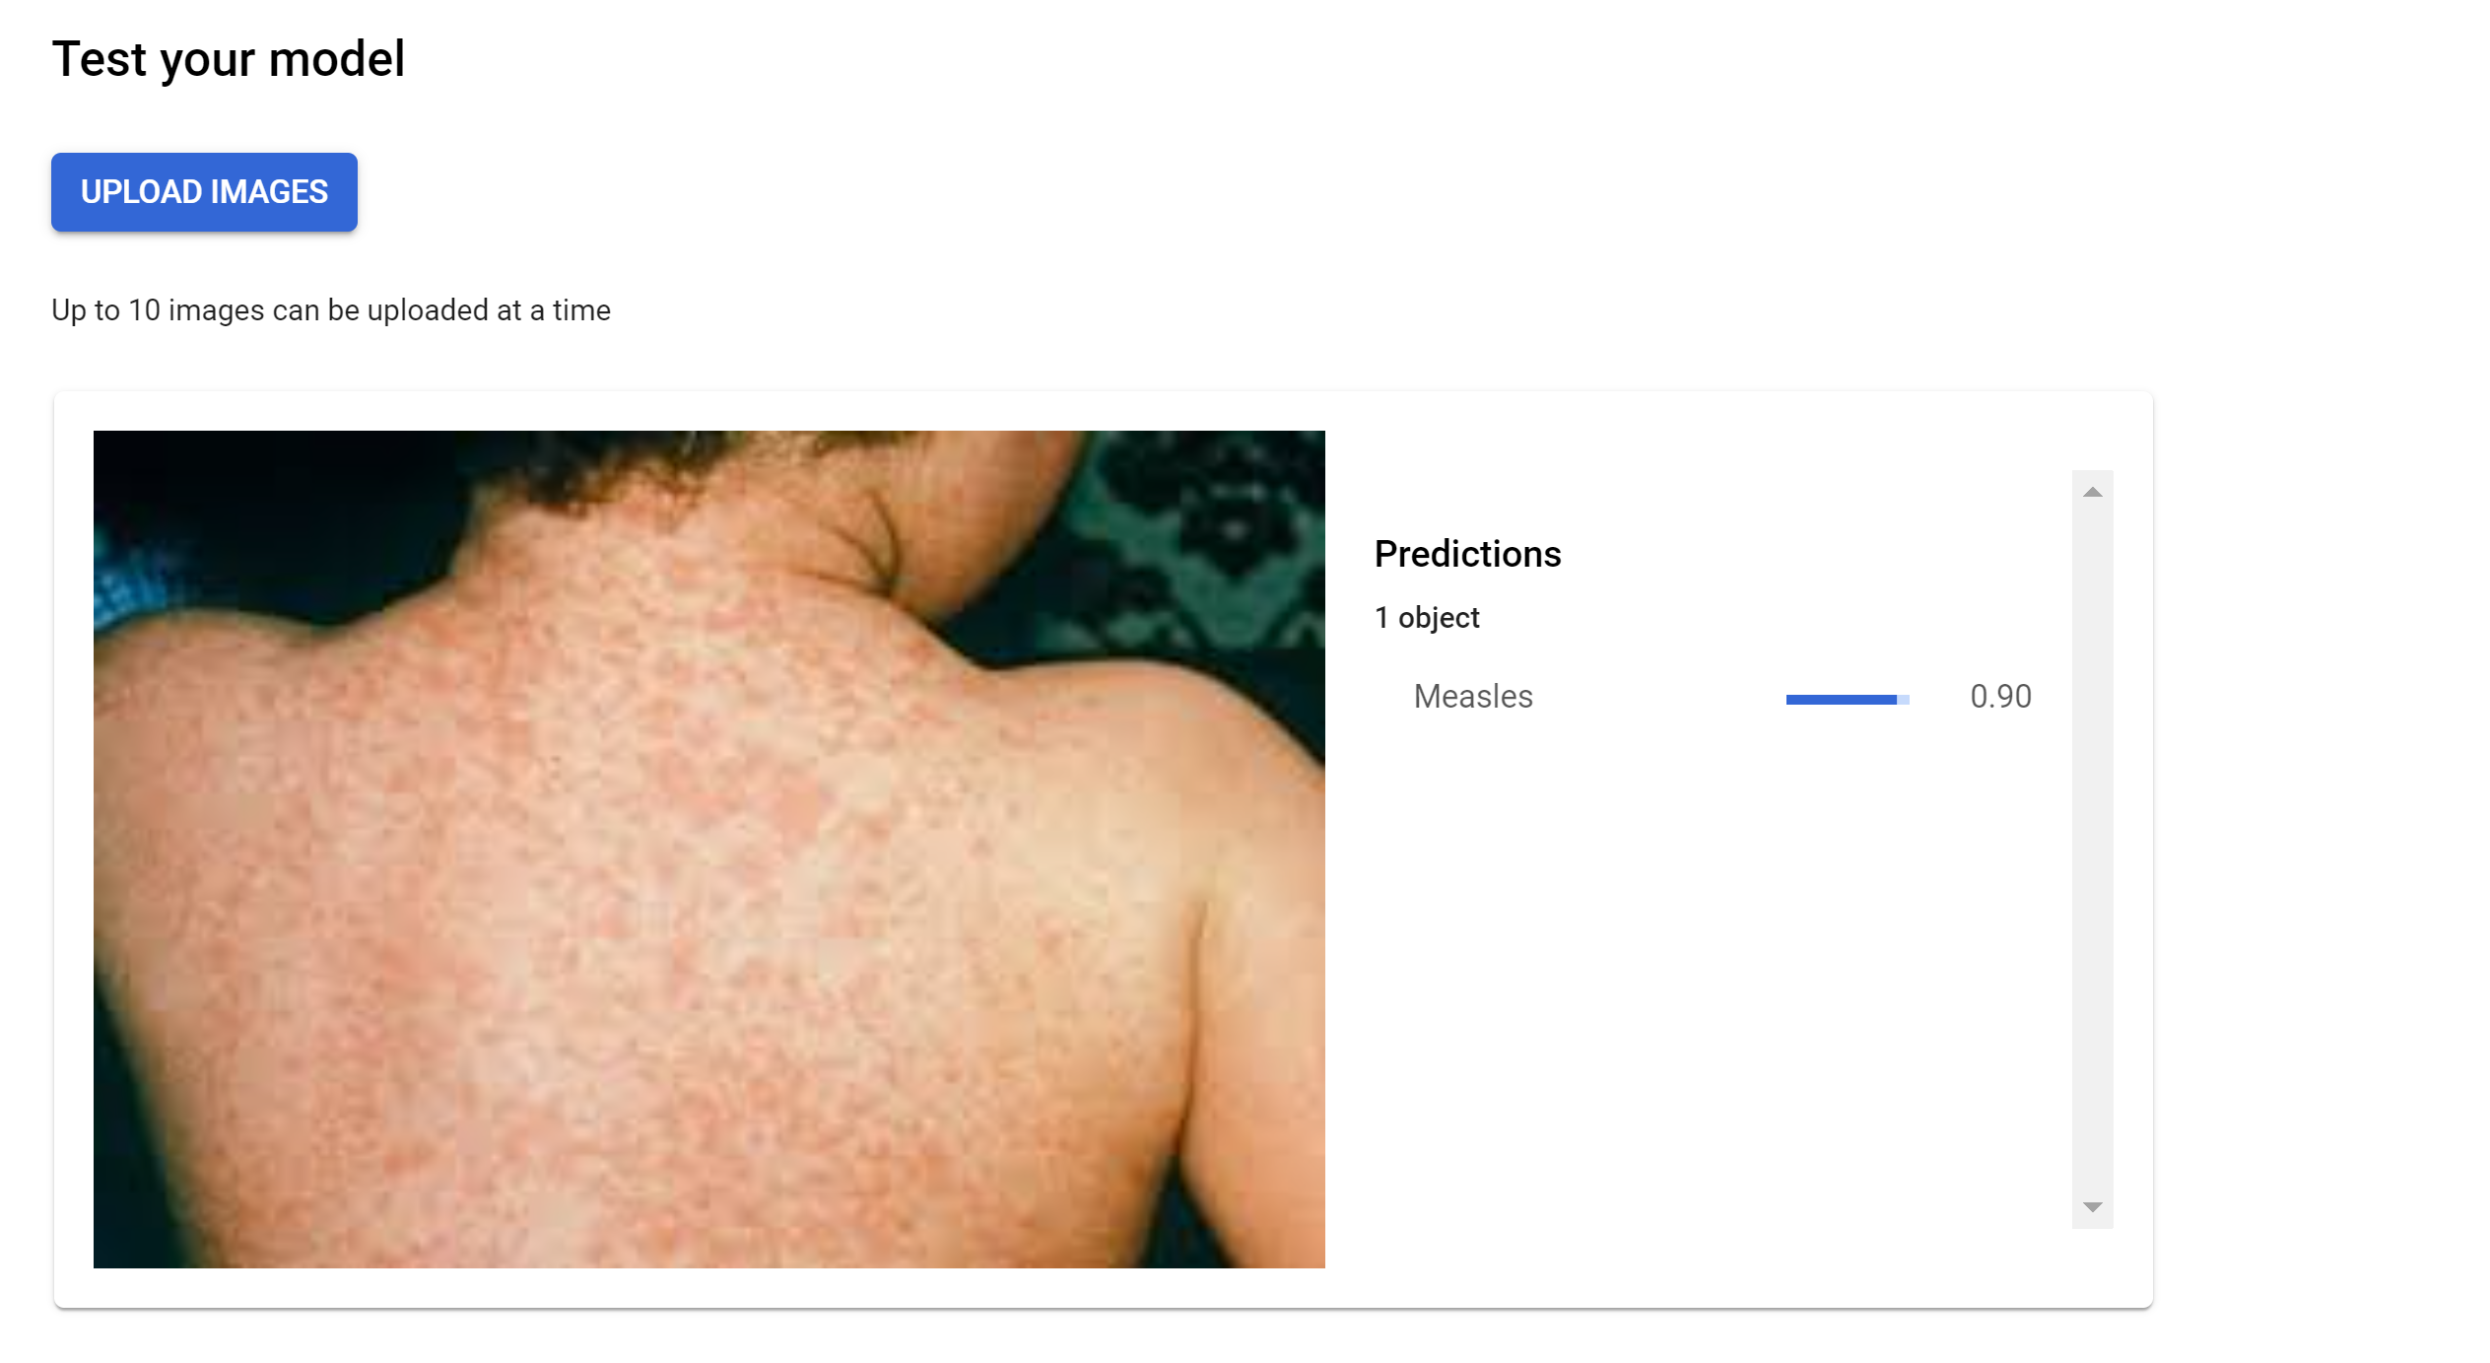
We can test our model directly from the google cloud platform by uploading our image. The result of the prediction will be printed and the score (the score is the probability of being predicted right) as well.

Slide 14
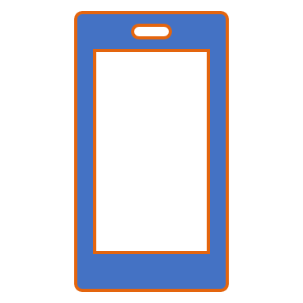
Our Mobile Application

Slide 15
How did we integrate the model with the mobile application?
from flask import Flask, Response, request,jsonify import requests # to get image from the web import shutil app = Flask(__name__) from google.cloud import automl_v1beta1 def get_prediction(content): # 'content' is base-64-encoded image data. prediction_client = automl_v1beta1.PredictionServiceClient() name = 'projects/utility-range-299820/locations/us-central1/models/ICN6871870707786055680' payload = {'image': {'image_bytes': content }} params = {} request = prediction_client.predict(name, payload, params) return request @app.route('/', methods=['POST']) def get_data(): image_url = request.data.decode('UTF-8') filename = image_url.split("/")[-1] r = requests.get(image_url, stream=True) # Open the url image, set stream to True, this will return the stream content. if r.status_code == 200: # Check if the image was retrieved successfully r.raw.decode_content = True # Set decode_content value to True, otherwise the downloaded image file's size will be zero. with open(filename, 'wb') as f: # Open a local file with wb ( write binary ) permission. shutil.copyfileobj(r.raw, f) ff = open(filename, 'rb') content = ff.read() print(content) print('Image sucessfully Downloaded: ', filename) else: print('Image Couldn\'t be retreived') json_file = {} json_file['response'] = str(get_prediction(content)) return jsonify(json_file) if __name__ == '__main__': app.run(debug=True)
we used python client to upload the image and get the prediction from the model in the google cloud platform using automl_v1beta1 library.
we used flask library to download the image on the local server to integrate the python code with the image taken in the flutter application
And Here is the code:

Slide 16
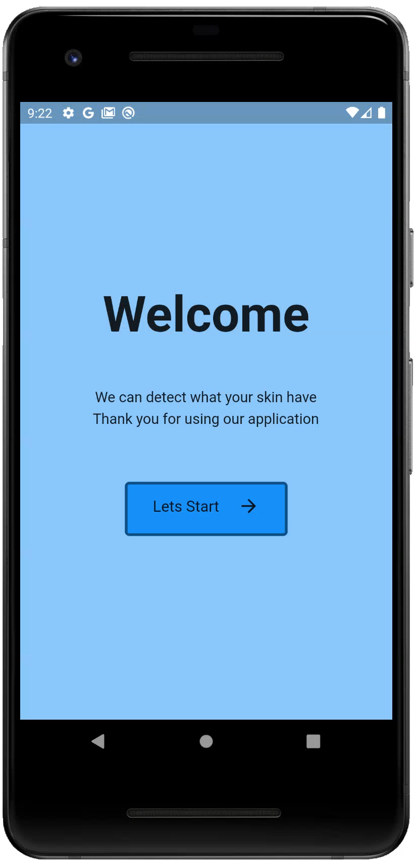
The Output of the app
Our mobile application is made by flutter UI platform using dart language.
And here is a video to show how the application works:

Slide 17
Conclusion and Summary
Detection of skin diseases is a very important step to reduce death rates, disease transmission and the development of the skin disease.
In this project we mainly depend on Google Cloud Platform (GCP) to make our machine learning model.
A Dataset of 8 diseases were used with an accuracy rate of 80%.
And finally, the model was integrated with a mobile application to be easily used.

Slide 18
Thank you

